Slide 1
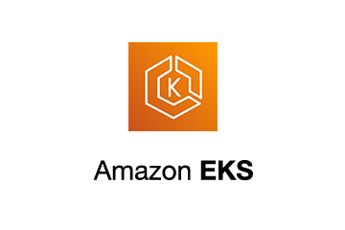
EKS
EKS Install and app deploy with Ingress

Slide 2
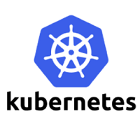
Kubernetes & EKS
Kubernetes is open-source software.
It helps you deploy and manage containerized applications.
Kubernetes has a large community.
EKS
AWS continuously keeps the AWS EKS service updated to the latest Kubernetes features.
AWS Elastic Kubernetes Service is also called AWS EKS
EKS is a managed service that lets you run Kubernetes on AWS.
It is built for scaling with Kubernetes.
How AWS EKS works
AWS EKS is used to run and scale Kubernetes applications in the cloud and on-premises.
Deploy applications in different ways:
Cloud Deployment
Deployment on your infrastructure
Deployment with your tools

Slide 3
EKS CLUSTER
An Amazon EKS cluster consists of two primary components:
Master Node or Kubernetes Control Plane. The master node in a Kubernetes architecture is used to manage the states of a cluster. It is actually an entry point for all types of administrative tasks.
Components:API Server , Scheduler, Controller Manager,ETCD
Worker/Slave node
The Worker node in a Kubernetes is also known as minions. A worker node is a physical machine that executes the applications using pods
Components:Kubelet , Kube-proxy, Pods

Slide 4
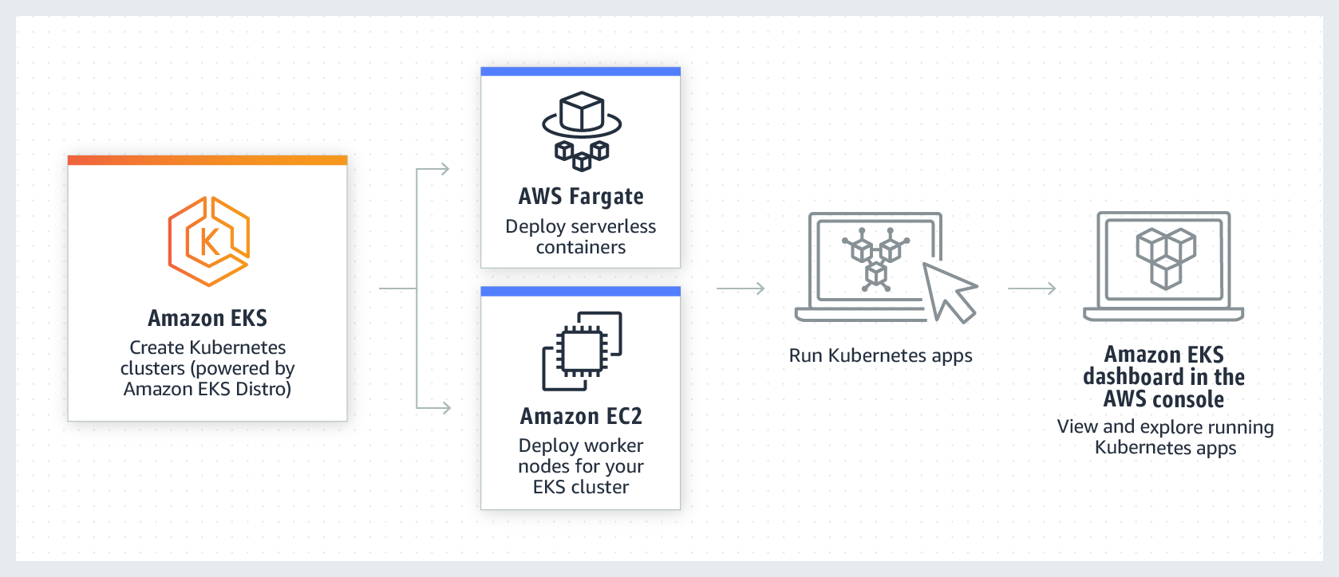
FARGATTE/Ec2
You can attach worker nodes by using both – letting most workloads be deployed using Fargatte (aws serverless compute , defined for running containers)and the more 'needy' workloads deployed on EC2.

Slide 5
kubeadm vs kops vs kubespray
all tools that can help deploy Kubernetes clusters:
Kubeadm
A lightweight tool that's good for quickly building minimum viable clusters. It's ideal for local development and trying out Kubernetes for the first time. However, it's not recommended for production clusters that require autoscaling.
Kops
An open-source project that enables users to create, update, or delete Kubernetes clusters from the command line interface. It supports automated infrastructure creation and is considered the "kubectl" way of creating clusters.
Kubespray
A combination of Kubernetes and Ansible that provides deployment flexibility. It's made up of Ansible playbooks, inventory, provisioning tools, and domain knowledge

Slide 6
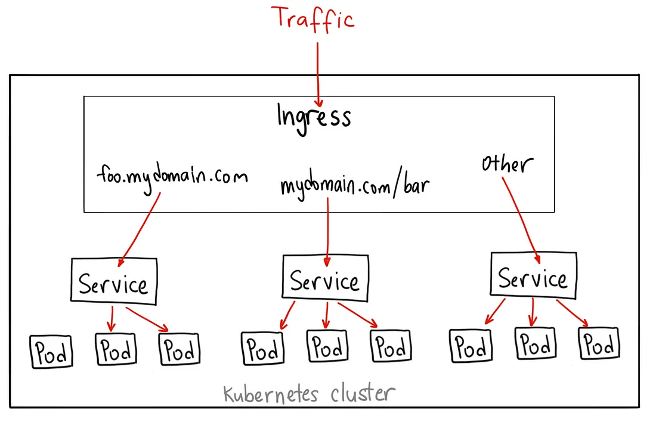
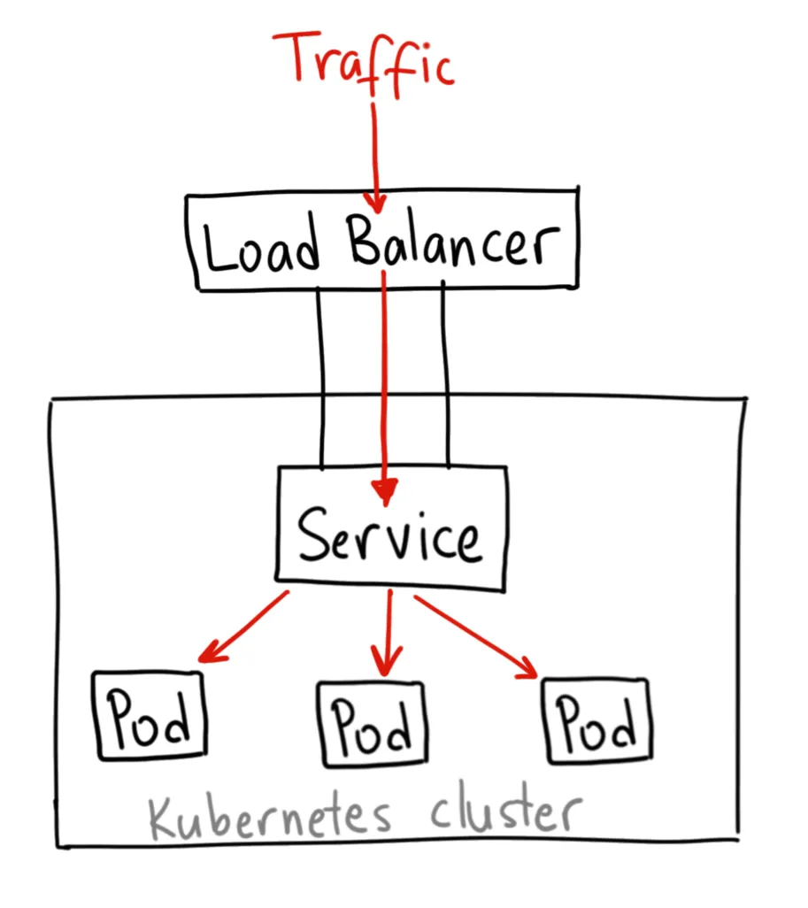
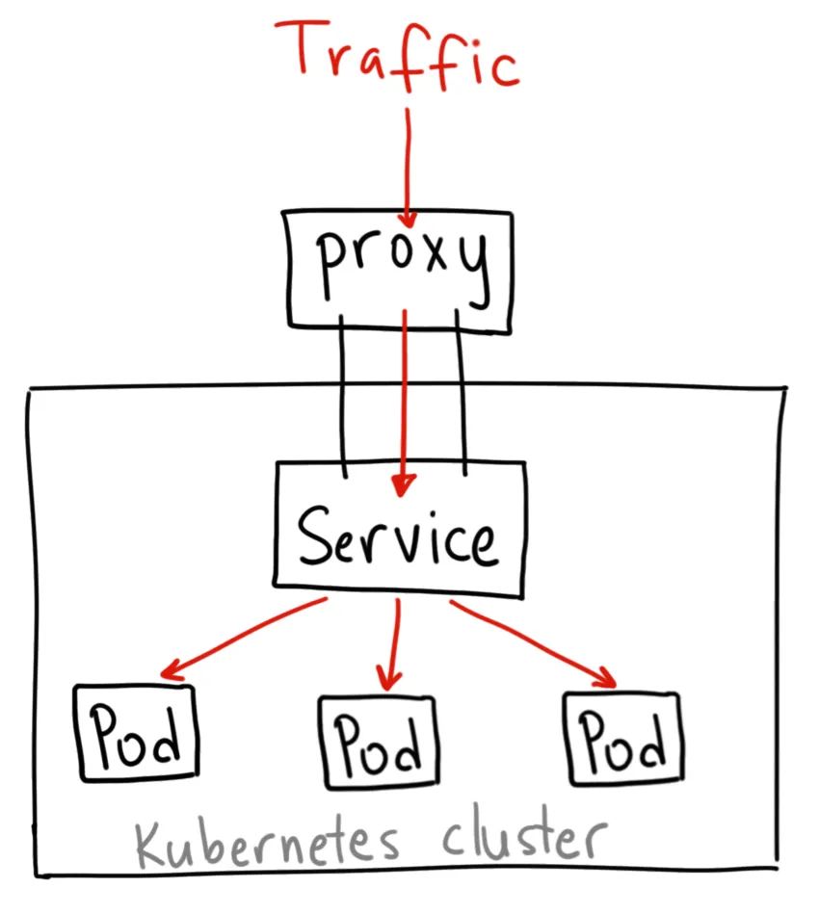
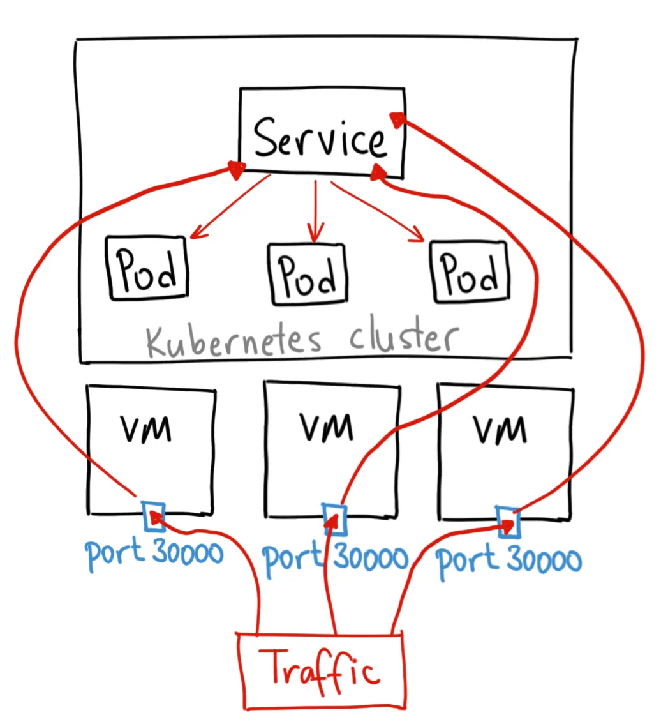
clusterip vs nodeport vs loadbalancer vs ingress creating a service

Slide 7
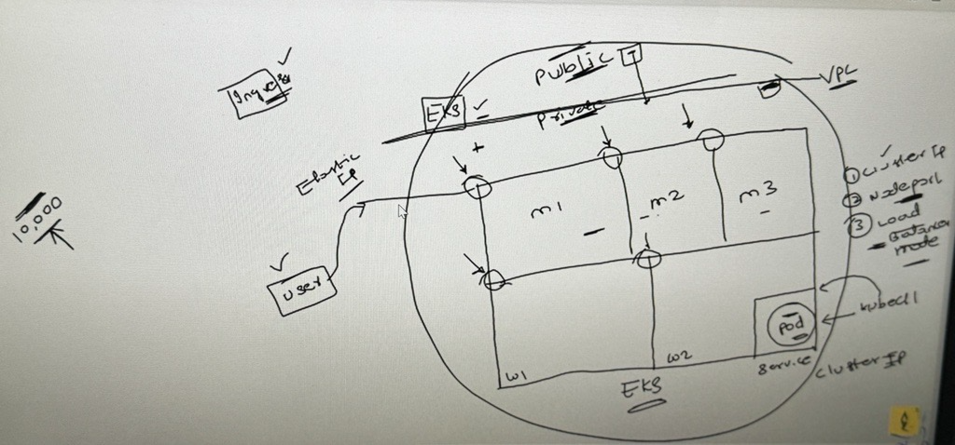
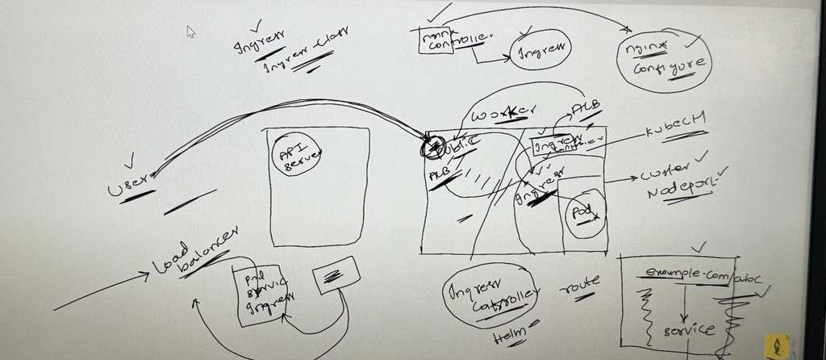

Slide 8
*Step 1: Installing the required tools**
1. Install and configure the AWS CLI : A command line tool for working with AWS services, including Amazon EKS
aws configure
2. Install [kubectl] :A command line tool for working with Kubernetes clusters.
curl -LO "https://dl.k8s.io/release/$(curl -L -s https://dl.k8s.io/release/stable.txt)/bin/linux/amd64/kubectl"
sudo install -o root -g root -m 0755 kubectl /usr/local/bin/kubectl
eksctl- A command line tool for working with EKS clusters that automates many individual tasks
nano eksctl.sh
ARCH=amd64
PLATFORM=$(uname -s)_$ARCH
curl -sLO "https://github.com/weaveworks/eksctl/releases/latest/download/eksctl_$PLATFORM.tar.gz"
# (Optional) Verify checksum
curl -sL "https://github.com/weaveworks/eksctl/releases/latest/download/eksctl_checksums.txt" | grep $PLATFORM | sha256sum --check
tar -xzf eksctl_$PLATFORM.tar.gz -C /tmp && rm eksctl_$PLATFORM.tar.gz
sudo mv /tmp/eksctl /usr/local/bin
chmod +x eksctl.sh
sudo sh eksctl.sh

Slide 9
**Step 2: Creating an EKS Cluster**
eksctl create cluster --name demo-cluster --region us-east-1 –fargate
Configuring kubectl for EKS:
aws eks update-kubeconfig --name your-cluster-name
Create Fargate profile
eksctl create fargateprofile \
--cluster demo-cluster \
--region us-east-1 \
--name alb-sample-app \
--namespace game-2048

Slide 10
Deploy the deployment, service and Ingress
kubectl apply -f https://raw.githubusercontent.com/kubernetes-sigs/aws-load-balancer-controller/v2.5.4/docs/examples/2048/2048_full.yaml
kubectl get pods -n game-2048
kubectl get pods -n game-2048 -w
kubectl get svc -n game-2048
kubectl get ingress -n game-2048
commands to configure IAM OIDC provider
export cluster_name=demo-cluster
oidc_id=$(aws eks describe-cluster --name $cluster_name --query "cluster.identity.oidc.issuer" --output text | cut -d '/' -f 5)
Check if there is an IAM OIDC provider configured already
eksctl utils associate-iam-oidc-provider --cluster $cluster_name --approve

Slide 11
How to setup alb add on
1. Download IAM policy
curl -O https://raw.githubusercontent.com/kubernetes-sigs/aws-load-balancer-controller/v2.5.4/docs/install/iam_policy.json
2. Create IAM Policy
aws iam create-policy \
--policy-name AWSLoadBalancerControllerIAMPolicy \
--policy-document file://iam_policy.json
3. Create IAM Role
eksctl create iamserviceaccount \
--cluster=<your-cluster-name> \
--namespace=kube-system \
--name=aws-load-balancer-controller \
--role-name AmazonEKSLoadBalancerControllerRole \
--attach-policy-arn=arn:aws:iam::<your-aws-account-id>:policy/AWSLoadBalancerControllerIAMPolicy \
--approve

Slide 12
Deploy ALB controller
1.installing helm
curl https://get.helm.sh/helm-v3.10.2-linux-amd64.tar.gz -o helm-v3.10.2-linux-amd64.tar.gz
tar -zxvf helm-v3.10.2-linux-amd64.tar.gz
sudo mv linux-amd64/helm /usr/local/bin/helm
2.checking helm version
helm version
3. Add helm repo
helm repo add eks https://aws.github.io/eks-charts
4. Update the repo
helm repo update eks
5. Install
helm install aws-load-balancer-controller eks/aws-load-balancer-controller \
-n kube-system \
--set clusterName=<your-cluster-name> \
--set serviceAccount.create=false \
--set serviceAccount.name=aws-load-balancer-controller \
--set region=<region> \
--set vpcId=<your-vpc-id>

Slide 13

Verify that the deployments are running.
kubectl get deployment -n kube-system aws-load-balancer-controller
kubectl get pods -n kube-system -w
]kubectl get deploy -n kube-system -w
kubectl get ingress -n game-2048
After checking ingress we will get some address that matches the DNS name which was created in our Load Balancer
Check the LB is created or not and wait until the LB state is active
Copy this add/DNS name in new tab ,we will get 2024 game
This is exactly what we deployed ,accessing the LB & through we are getting requests
Delete the cluster
eksctl delete cluster --name demo-cluster --region us-east-1
---to avoid billing

Slide 14
EKS service : Pros and Cons
PROS:
Managed Control Plane
Automated Updates
Scalability
AWS Integration
Security and Compliance
Monitoring and Logging
Ecosystem and Community
CONS :
Cost: EKS is a managed service, and this convenience comes at a cost. Running an EKS cluster may be more expensive compared to self-managed Kubernetes, especially for large-scale deployments.
Less Control: While EKS provides a great deal of automation, it also means that you have less control over the underlying infrastructure and some Kubernetes configurations.

